Slide 1
Impedance Matching Techniques
Impedance matching is necessary to provide maximum delivery of RF power to load from source
Impedance matching using :
Lumped elements
Quarter-Wave transformer
Single-Stub Tuner
Double-Stub Tuner

Slide 2
BandWidth
Highest frequency of band, Hz
Lowest frequency of band, Hz
Design or center frequency, Hz

Slide 3
λ/4 section bandwidth
Z_{L} = 400Ω
Z₀=100 Ω
f_{o} = 300 Hz
Find:
VSWR at f_{low} = 150 Hz
VSWR at f_{high} = 450 Hz
BW for VSWR <=1.5
BW for VSWR <= 1.2

Slide 4
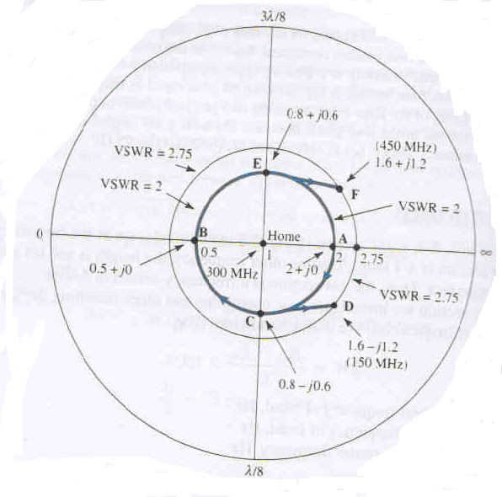

Slide 5
Impedance Matching Techniques
Impedance matching is necessary to provide maximum delivery of RF power to load from source
Impedance matching using :
Lumped elements
Quarter-Wave transformer
Single-Stub Tuner
Double-Stub Tuner

Slide 6
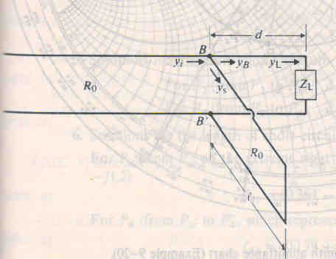
Single-Stub Matching

Slide 7
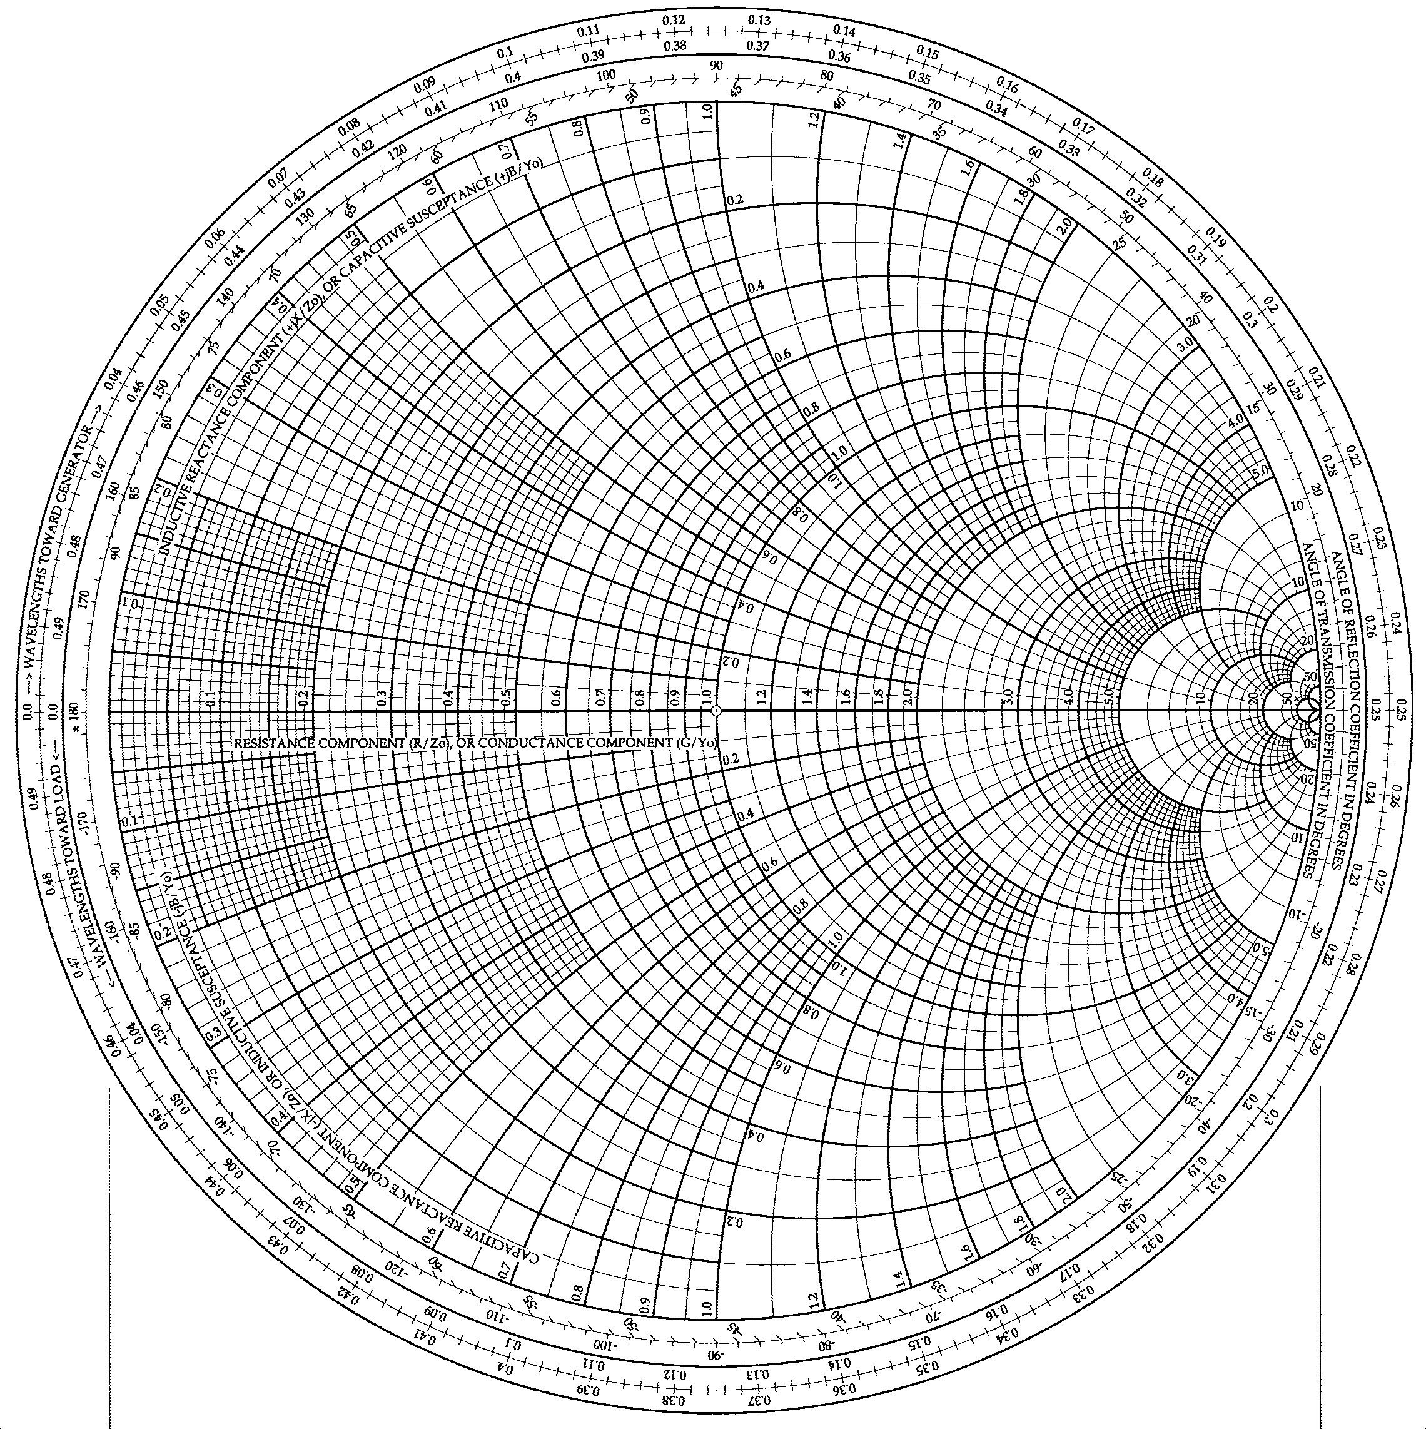
A 50-Ω T-L is terminated in an impedance of
Z_{L} = 35 - j47.5. Find the position and length of the short-circuited stub to match it.
WTG = .109λ
WTG = .168λ
y_{L}
Normalize Z_{L}
z_{L} = 0.7 – j0.95
y_{B}
Find z_{L} on S.C.
Draw Γ circle
Convert to y_{L}
Find r=1 circle
Find intersection of Γ circle and r=1 circle (y_{B})
Find distance traveled (WTG) to get to this admittance
z_{L}
This is d_{STUB}
d_{STUB} = (.168-.109)λ
d_{STUB} = .059λ

Slide 8
b_{B} = 1.2
Find b_{B}
Locate P_{SC}
y_{B}
Set b_{STUB} = b_{B} and find y_{STUB} = -jb_{STUB}
WTG = 0.25λ
Find distance traveled (WTG) to get from P_{SC} to b_{STUB}
P_{SC}
This is L_{STUB}
L_{STUB} = (0.361-0.25)λ
L_{STUB} = .111λ
Our solution is to place a short-circuited stub of length .111λ a distance of .059λ from the load.
y_{STUB} = -1.2
WTG = 0.361λ

Slide 9
There is a second solution where the Γ circle and r=1 circle intersect. This is also a solution to the problem, but requires a longer d_{STUB} and L_{STUB} so is less desirable, unless practical constraints require it.
WTG = .109λ
y_{L}
y_{B1}
d_{STUB} = (.332-.109)λ
d_{STUB} = .223λ
L_{STUB} = (.25+.139) λ
L_{STUB} = .389 λ
y_{B2}
z_{L}
WTG = .332λ

Slide 10
A load of 100 + j150 ohm is connected to a 75 ohm lossless line. Find

